Slide 1

MOBILE APPLICATION Development (114155)
Dr. Owais Hussain

Slide 2

Agenda
Android Platform
Software Developer Kit
Android Activity
Services, BroadcastReceiver, ContentProvider, Intents, Fragments
Building APK
Example: Baham App

Slide 3
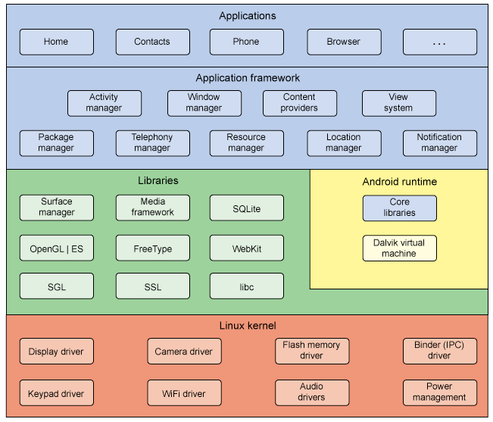
Sample 2
Android Platform
Kernel
Native Libraries
Android Runtime
Application Framework
Applications
Notes:
Binder IPC: Inter-process communication
Kernel is lightweight OS based on Linux
SGL: Scene Graph Library for real-time visualization and gaming
SSL: Secure Socket Layer
OpenGL (ES): Open Graphics Library for Embedded Systems
Webkit: browser engine
FreeType: font engine
Surface manager: draw windows and other app surfaces

Slide 4
Sample 2
Android Platform
Standard Linux Kernel:
Memory/Process management
Files and I/O
Device/Sensor drivers
Android Specific:
Power management
Memory sharing
Inter-process communication (binder)

Slide 5
Sample 2
Android Platform
Native Libraries:
Rendering webpages
Updating display
Android’s own System C Library
Media framework for Audio/Video
OpenGL and Scene Graph Library for real-time visualization and high-performance graphics (like gaming)
SQLite, a compact RDBMS

Slide 6
Sample 2
Android Platform – Android Runtime
Core JAVA Libraries
Basic Java utilities
Web services
Unit testing framework
App Lifecycle
Custom Java Virtual Machine (Dalvik)
Executes Android Apps
Notes:
If it is made in Java, it can be ported to Android

Slide 7
Sample 2
Android Platform – Application Framework
View System provides icons, labels, buttons, inputs=, …
Package Manager keeps track of all installed Apps
Window Manager manages various Windows like Top bar, main Application Window and Bottom Menu
Resource Manager manages Non-compiled resources like Strings, XML, Layout files, Graphical assets
Activity Manager Starts app activities, Pauses/Resumes them, navigate back and forth between activities
Content Provider enables data sharing between Apps
Can you guess what Location Manager and Notifications Manager does?
Notes:
App Framework is a suite of reusable software frequently used by Apps
Android manages multiple languages in Resource Manager

Slide 8
Sample 2
Android Platform – Application
Built-in Apps
All applications which come with Vanilla Android
None of these Apps are hard-coded
3rd Party Apps
Installed via Stores
Installed insecurely

Slide 9
Sample 2
Software Developer Kit
SDK Platform (which one to choose?)
SDK Tools
Build tools
Android Studio and its key features
Emulator
Debugger
UI Hierarchy
Gradle builder (be patient when compiling first time)
Notes:
Launch and Show Android Studio
Launch and Show Android Emulator
Launch and Show Android Debugger
Open “Hierarchy View“ Perspective of Android Studio; Go to Window panel
Min SDK version decides how many devices can run this app
Gradle is successor of Ant builder. It is not Android specific. Its job is to compile code and manage dependencies

Slide 10
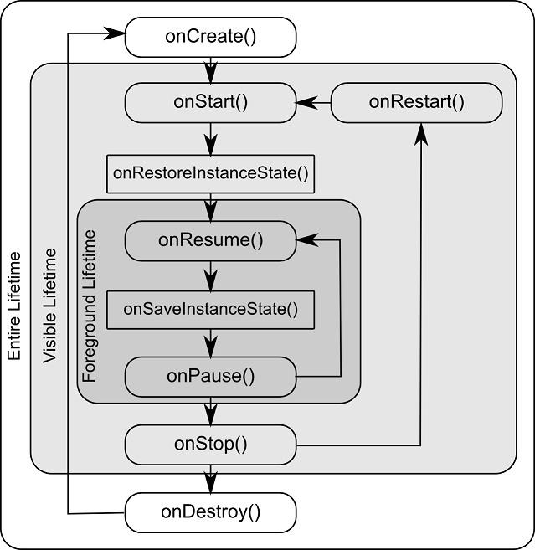
Sample 2
Android Activity
The first class which launches the GUI
Reads user input and provides output
An Activity should do one thing and do it well
Activity Lifecycle
Notes:
App is allocated all resources in Created state but is not visible
App is visible in Started state but does not interact
App is visible and interactive in Resumed and Running states
App is visible but does not interact in Paused state
App is not visible in Stopped state, and is ready for termination
Destroyed app is terminated and cleaned from memory

Slide 11
Sample 2
Android Activity
When an App opens: onCreate() -> onStart() -> onResume()
When Back button is pressed and App exits: onPaused() -> onStop() -> onDestroy()
When Home button is pressed: onPaused() -> onStop()
When any dialog opens: onPause()
When an open dialog is dismissed: onResume()
Switching to App from Home onRestart() -> onStart() -> onResume()

Slide 12
Sample 2
Android Activity - Example
onCreate()
Check if the login details are stored for auto-login
onRestart()
Bring to search View
onResume()
Show pre-filled search text
onPause()
Store snapshot of existing view
onStop()
Cache the search results into DB
onDestroy()
Close connections
Notes:
Explain in Baham App context. Like a user is trying to search for available Owners for ride sharing

Slide 13
Sample 2
Service, Broadcast Receiver, Content Provider
None of these have a GUI and work behind the scenes
Services run in the background, usually long-running
Broadcast Receivers listen and respond to Device Events
Extend BroadcastReceiver class and must implement onReceive() method
Content Provider stores App data, and controls sharing of data between applications
Notes:
Events use Subscriber software pattern (a.k.a. Observer pattern). These are represented by Intent class. If the Subject (e.g., a sensor) changes, the Intent object is notified, which executes a function as a response.

Slide 14
Sample 2
Intents
It’s a Data structure which:
Activities use Intents to specify an operation user wants to perform
Intents also notify Activities when an Event occurs
Intent Fields:
Action: e.g. ACTION_DIAL meaning the Intent will dial a number
Data: the URI pointing to the data associated with the Intent
Category: e.g. CATEGORY_BROWSABLE meaning this Intent can be invoked by a Browser
Type: the MIME type, like IMAGE/*, TEXT/HTML, just like we do on HTTP
Component: identifies the associated Activity, e.g., Intent(Context context, MainActivity.class)
Extras: used to store extra information. Usually a Map<Key, Value>
Flags: e.g. FLAG_ACTIVITY_NO_HISTORY (self explanatory)
Notes:
Intents can say: I want to take a photo, or I want to download a file from web
URI is Uniform Resource Identifier
Component: if there’s only 1 specific Activity which can invoke this Intent, then it will be specified as Intent component

Slide 15
Sample 2
Fragments
An Activity can host multiple parts, called Fragments
A fragment represents a portion of UI within an Activity
Fragments cannot independently launch
They have a lifecycle of their own, but it is tied with the lifecycle of the host Activity
Notes:
Fragments can only be int Resumed, Paused or Stopped states

Slide 16
Sample 2
Building an APK (Android PacKage)
Building an APK is the process of following sequence of actions:
Compile the Android Project
Package the compiled files into .apk file which includes all .dex files, resources.arsc, AndroidManifest.xml file and all non-compiled files
The APK is digitally “signed” for validation and verification
APK is copied and executed to an Android Device or Emulator

Slide 17
Sample 2
Example: Baham App
Creating a new app on Android Studio
Build and Run on Emulator
MainActivity class
setContentView()
Directories: values, layout, drawable
XML-based resources
Modify main_activity.xml layout
R file and accessing its resources

Slide 18
Sample 2
Extras: Threads and Asynchronous Tasks
Android can run many programs simultaneously, but they are slightly different than vanilla Java threads
Thread: start() -> run(), sleep(time), wait(), notify()
UI Thread: App’s demon thread, which keeps running. All lifecycle methods by UI thread
If the UI needs to be updated by a thread, use Activity.runOnUiThread(Runnable) instead of generic thread
Notes:
Flashback: A thread has a Program counter and a Stack. Heap memory is used to share data with other threads.
NEVER block the UI Thread. Create long-running threads in the background

Slide 19
Sample 2
Extras: Threads and Asynchronous Tasks
AsyncTask class: a generic class which inputs Parameters, Progress and Result.
First, onPreExecute() is run in UI thread
Next, doInBackground(Params) is run as a background thread using the parameters
Optional: while the doInBackground() is running, call publishProgress(Progress values) to let the UI thread know of the progress
Finally, onPostExecute() is run in UI thread

Slide 20
Sample 2
Extras: Threads and Asynchronous Tasks
Handler class: can be associated with any thread.
Example:
Thread A is performing some work X. It wants to switch to another work Y, but also wants X to be carried on.
B implements Runnable and has a handler object.
A sends a Message object (containing data about X) to handler of B
B now has the Message object in its Message Queue
As B dequeues the message, it will unpack the message and carry on the work
Once B is finished, or wants to hand over the remaining work back to A, it will send a Message object to A’s handler.
Notes:
Hacking tip! Threads can call sendMessageAtFrontOfQueue() method to bypass entire Queue of worker thread and make the task a priority.

Slide 21
Sample 2
Extras: Data Management
Shared Preferences: used like Cache storage
Internal Storage: App’s own private data repository, which cannot be accessed by other apps
External Storage: large amount of data, available to other Apps
Android uses Files for both Internal/External data. Parameter “mode” defines whether the file is internal or external
Database: SQLiteDB for private, structured data
Notes:
Shared preferences is a map of Key-value pairs. They are persisted before onDestroy is called.

Slide 22
Sample 2
Extras: Data Management
SQLite DB uses a Helper subclass
onCreate() method
onUpgrade(db, oldVersion, newVersion) method
deleteDatabase() method
Move forward management strategy
DB Cursors are used to navigate between records
SQLiteDB can be examined using 3rd party explorers
Notes:
onCreate is called to create first version of DB
onUpgrade is called in hierarchical method to implement changes

Slide 23



THANK YOU
Owais Hussain
+92 345-3174270
owais.hussain@kiet.edu.pk
https://www.researchgate.net/profile/Owais-Hussain-3

